Slide 1
Weird Animal Quiz

Slide 2
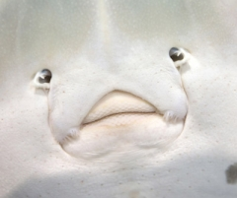
A few weeks after my birth, my body flattens, one of my eyes moves to the other side of my head and my mouth twists.
Who am I?
A sole
An alien
An animal under a steamroller

Slide 3
Answer: A sole
The fry (young) of the sole looks like a "normal" fish before turning into a flatfish. We hope that this metamorphosis is painless! Speaking of flatfish, two new species of rays as flat as pancakes have just been discovered in the Amazon River.

Slide 4
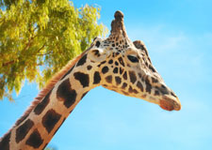
How many bones are there in a giraffe's neck?
None, because giraffes lack riboflavin
7
54, for maximum flexibility

Slide 5
Answer: 7

Slide 6
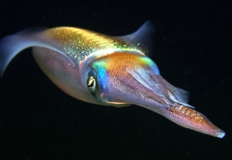
Squid can swim 15 times faster than a world champion swimmer.
True
False

Slide 7
Answer: True
Squid can swim 15 times faster than a world champion swimmer.
Squid can swim at 110km/h, faster than the speed allowed on the highway!

Slide 8
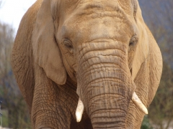
An elephant's trunk contains....
More than 100,000 muscles
A single powerful muscle
As many muscles as Dr. Octopus' arms

Slide 9
Answer: More than 100,000 muscles
An elephant's trunk contains more than 100,000 muscles. Thanks to them, the elephant's trunk is strong and accurate. It can lift 270 kg! It ends with two appendages (fingers) in the African elephant and only one in the Indian elephant.

Slide 10
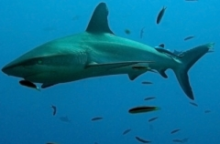
Sharks....
Take care of their skin
Put on fin varnish
Chew algae like gum

Slide 11
Answer: Take care of their skin
After a five-year study, scientists confirmed that sharks regularly visit the cleaning 10 cm long fish that remove dead skin and parasites. Duration of treatment: 45 minutes per shark. These fish also have a real "beauty salon" in their reef! They receive a wide variety of fish. They remove their broken scales and clean their wounds and teeth.

Slide 12
We submitted to the Guinness records, the candidacy of a cat that purrs as loudly as...
An explosion of a fireworks display
An evening at the Bell Center with Justin Bieber and his delirious fans
The engine of a lawnmower

Slide 13
Answer: The engine of a lawnmower
Smokey the cat’s purring reaches 93 decibels.
Photo from YouTube.

Slide 14
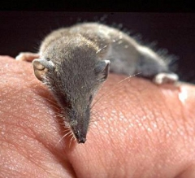
What is the smallest mammal in the world?
The Etruscan shrew
Pygmy marmoset
The ticulminus

Slide 15
Answer: The Etruscan shrew
It measures 5 cm. Since it consumes a lot of energy to maintain the warmth of its body, the shrew must swallow four times its weight in insects every day. The cute marmoset is the smallest monkey (15cm), but it is still bigger than the shrew. Did you know that the smallest bird in the world, the Cuban hummingbird (5cm, 1.6g), gives birth to chicks that weigh no more than a stamp?

Slide 16
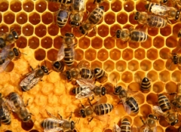
Bees are accurate to the thousandth of a millimetre when making their alveoli.
True
False

Slide 17
Answer: True
The wall thickness of the cells varies by a maximum of 0.002 mm! It's very precise! The honeycomb is an engineering marvel, abundantly copied in the construction industry. This structure absorbs shocks and resists deformation. It provides the highest strength with a minimum of materials. For example, a honeycomb made with only 20 g of wax can contain 1 kg of honey (50 times more).

Slide 18
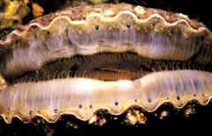
I grow eyes as I get older. Who am I?
Your grandmother
The mole
The scallop

Slide 19
Answer: The scallop
The scallop has more than 100 eyes, and the older it gets, the more it has! They are used to spot his sworn enemy... the starfish!
Photo : Wikimedia Commons.

Slide 20
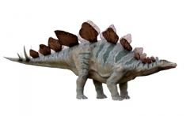
The stegosaurus' brain was the size of...
a bird
a nut
a small car

Slide 21
Answer: a nut
The relationship between brain weight and body weight gives an idea of an animal's intelligence. This is only one of many parameters, but it indicates that the stegosaurus was not very bright. According to paleontologists, one of the most intelligent dinos was the troodon, a carnivore whose brain was as big as a 40g bird.

